Slide 1
Verb BE PRACTICE
The three forms of the verb BE : am/am not – is/isn’t – are/aren’t
Notes:
<number>

Slide 2
tHe FOLLOWING MATERIALS ARE ABOUT THE VERB BE ( am – is – are ). Read the instructions, complete the sentences, and answer the questions.
I _am_____ an English student.
My family and I _are____ from Costa Rica originally.
Dr. Daniel Salas __is___ handsome.
Alajuela and Guanacaste __are____ very hot.
My mother __is___ 75 years old.
Notes:
<number>

Slide 3
What do you do? I __am____ an English student.
Where __are____ you from? We __are_____ Costa Rican.
What time __is__ it? It __is___ 3:30 p.m.
How old is your father? He __is____ 50 years old.
What __is____ Puerto Viejo beach like? It ___is____ very beautiful and clean.
Notes:
<number>

Slide 4
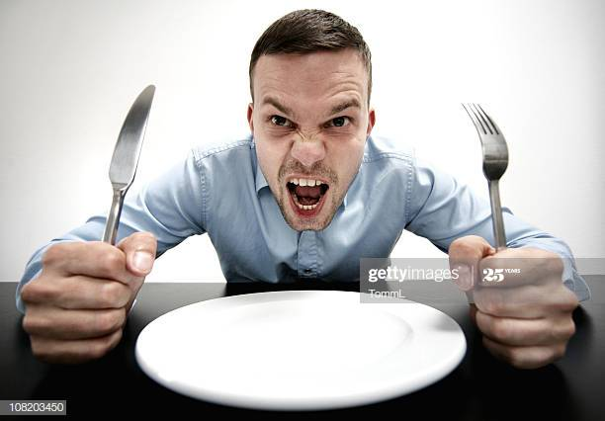
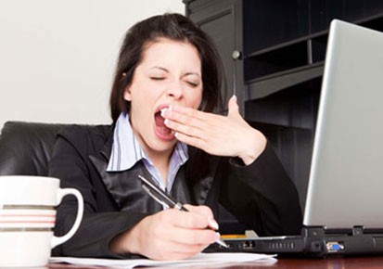
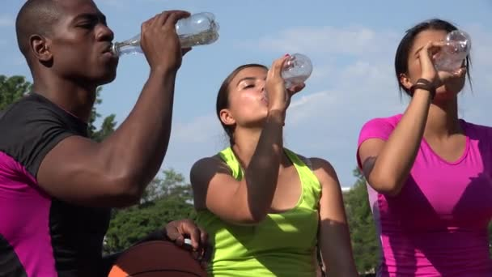
Look at the pictures, and write a sentence using the verb be:
1. He is very hungry __________________
2. I am in my office and I’m very tired
3. They are drinking
water ________________
Notes:
<number>

Slide 5
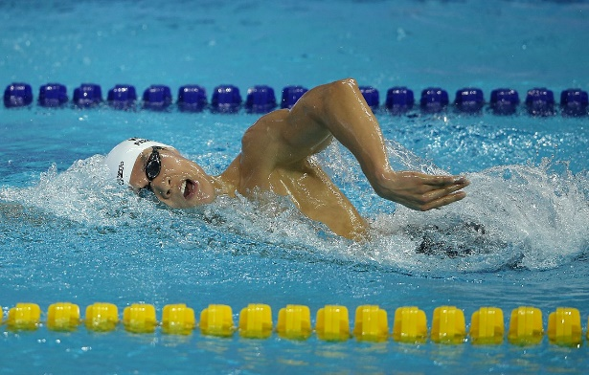
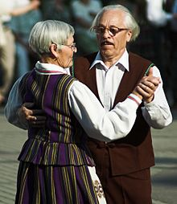
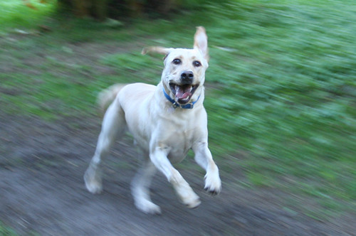

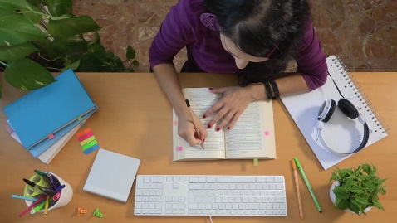
1. What is your brother doing?
2. What are your parents doing?
3. What is your pet doing?
4. What are your friends doing?
5. What are you doing?
Notes:
<number>

Slide 6

Do you have any questions?
Notes:
<number>

Slide 7
Thanks for your help!
Notes:
<number>

